Slide 1
交通大数据
对数几率回归

Slide 2
对数几率回归
❑ 学习目标
二项 Logistic 回归
多项 Logistic 回归

Slide 3
对数几率回归
❑ 学习目标
二项 Logistic 回归
多项 Logistic 回归

Slide 4
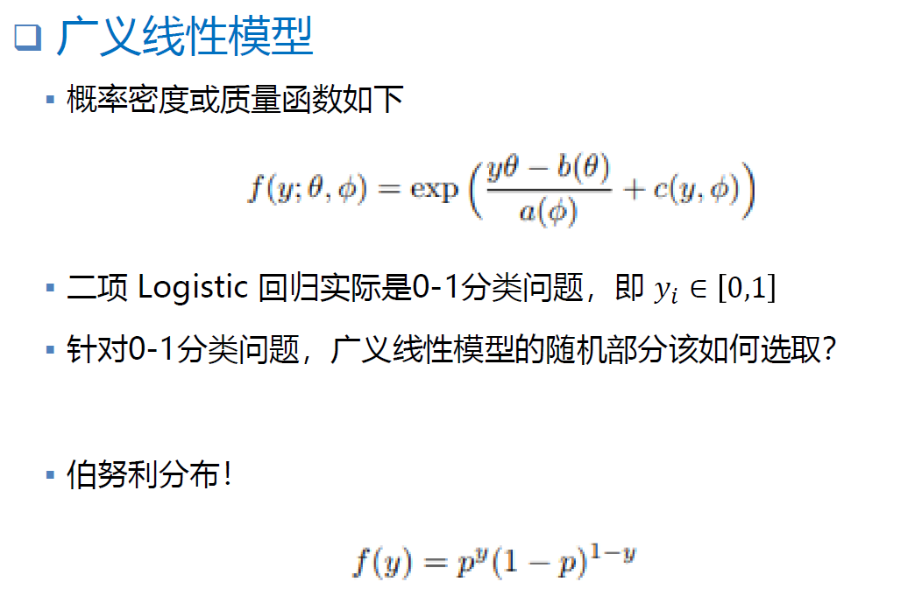


二项 Logistic 回归
❑ 广义线性模型
▪ 概率密度或质量函数如下
▪ 二项 Logistic 回归实际是0-1分类问题，即 yi ∈ 0,1
▪ 针对0-1分类问题，广义线性模型的随机部分该如何选取？
▪ 伯努利分布！

Slide 5

二项 Logistic 回归
❑ 广义线性模型
▪ 概率质量函数变形如下

Slide 6
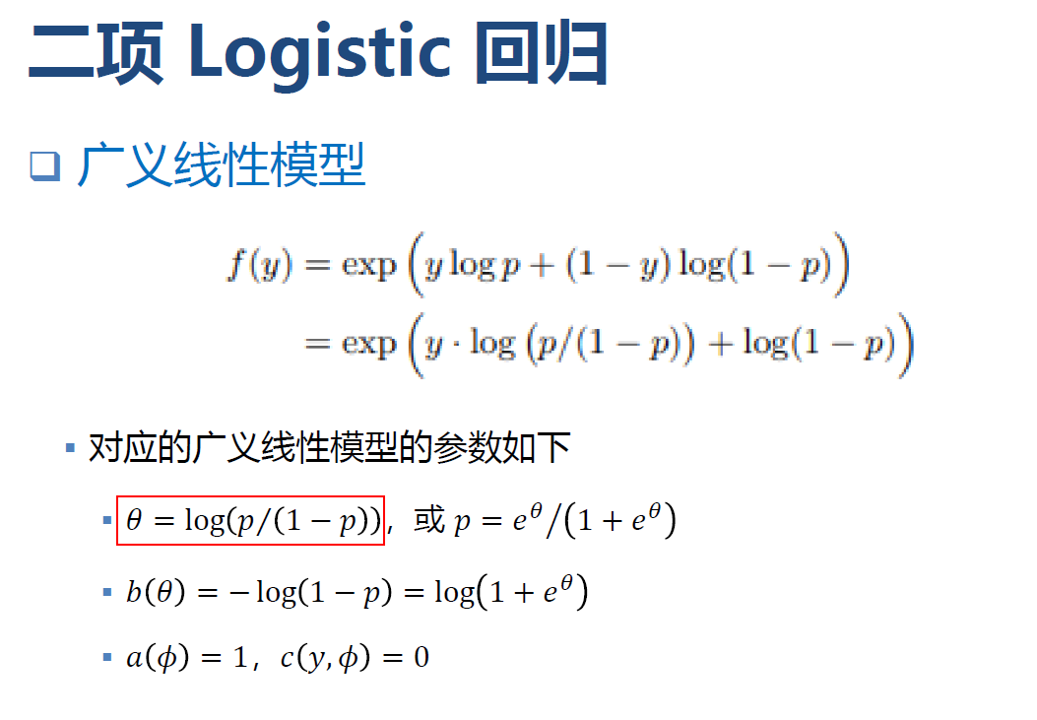
二项 Logistic 回归
❑ 广义线性模型
▪ 对应的广义线性模型的参数如下
▪ � = log 𝑝Τ 1 − 𝑝 ，或 𝑝 = 𝑒^{𝜃}ൗ 1 + 𝑒^{𝜃}
▪ � � = − log 1 − 𝑝 = log 1 + 𝑒^{𝜃}
▪ � 𝜙 = 1，� �, 𝜙 = 0

Slide 7
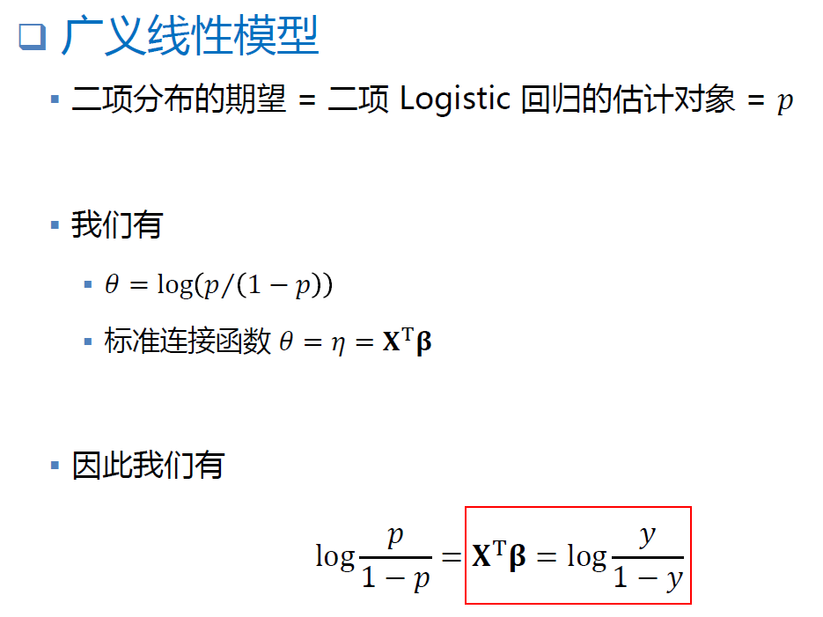
二项 Logistic 回归
❑ 广义线性模型
▪ 二项分布的期望 = 二项 Logistic 回归的估计对象 = 𝑝
▪ 我们有
▪ � = log 𝑝Τ 1 − 𝑝
▪ 标准连接函数 � = � = 𝐗^{T}𝛃
▪ 因此我们有
𝑝
�
log
= 𝐗^{T}𝛃 = log
1 − 𝑝
1 − �

Slide 8
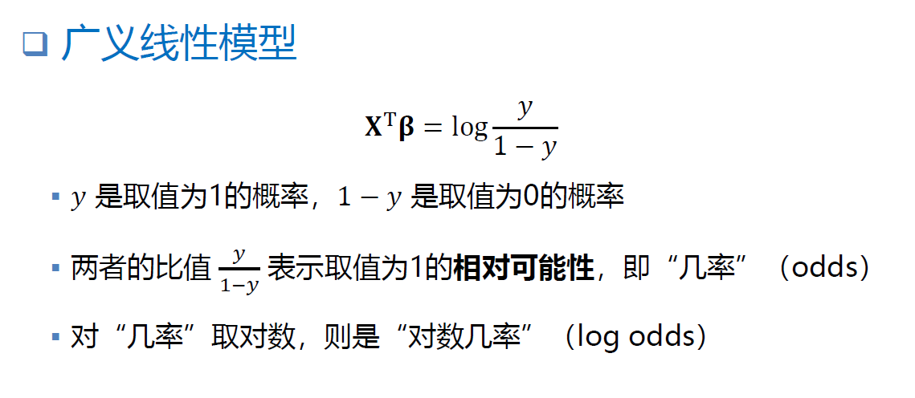
二项 Logistic 回归
❑ 广义线性模型
�
𝐗^{T}𝛃 = log
1 − �
▪ � 是取值为1的概率，1 − � 是取值为0的概率
▪ 两者的比值 � 表示取值为1的相对可能性，即“几率”（odds）
1−�
▪ 对“几率”取对数，则是“对数几率”（log odds）

Slide 9
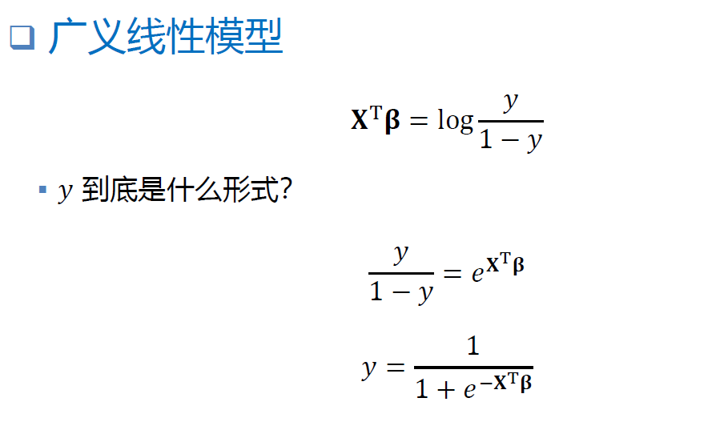
二项 Logistic 回归
❑ 广义线性模型
�
𝐗^{T}𝛃 = log
1 − �
▪ � 到底是什么形式？
�
_{= 𝑒}𝐗^{T}𝛃
1 − �
1
� =
_{1 + 𝑒}−𝐗^{T}𝛃

Slide 10
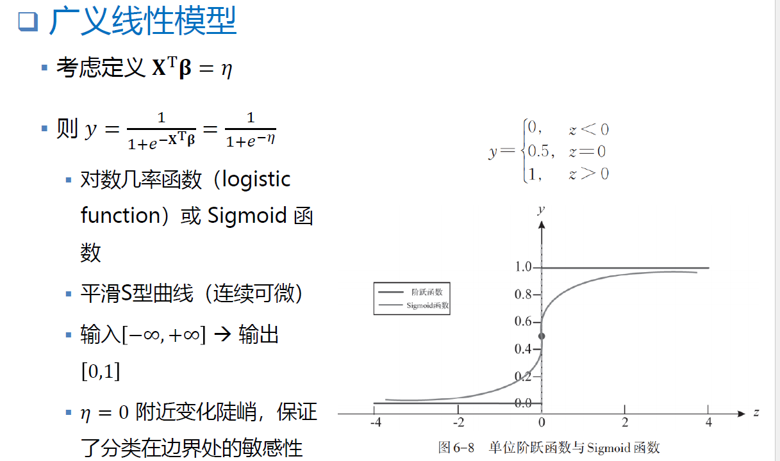
二项 Logistic 回归
❑ 广义线性模型
▪ 考虑定义 𝐗^{T}𝛃 = �
_{1+𝑒}−𝐗^{T}𝛃
1+𝑒^{−𝜂}

Slide 11
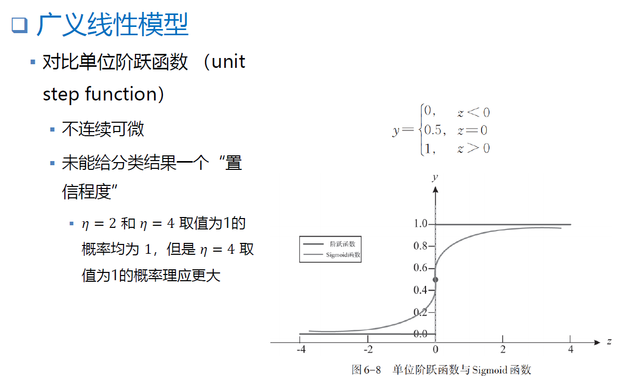
二项 Logistic 回归
❑ 广义线性模型
▪ 对比单位阶跃函数 （unit
step function）
▪ 不连续可微
▪ 未能给分类结果一个“置
信程度”
▪ � = 2 和 � = 4 取值为1的 概率均为 1，但是 � = 4 取 值为1的概率理应更大

Slide 12
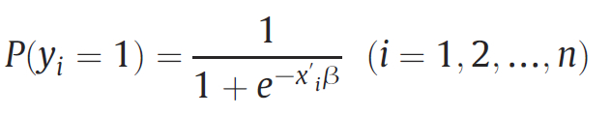

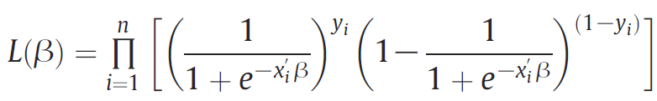
Logistic Regression
Using a logistic regression model, the probability of exceeding the speed limit under certain traffic conditions can be estimated using the following equation
where P(yi = 1) denotes the probability of exceeding the speed limit, and−x′_{i}β is the multiple linear combination of explanatory variables:
This model is estimable by standard maximum likelihood methods, with the likelihood function given as:

Slide 13

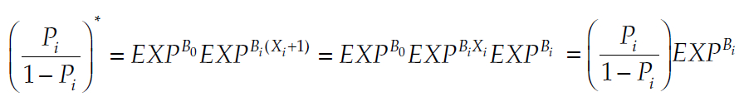
Logistic Regression
The interpretation of variable parameter in logistic regression:
The fundamental equation for the logistic regression shows that when the value of an independent variable increases by one unit, and all other variables are held constant, the new probability ratio [P_{i}/(1 – P_{i})] is given as

Slide 14
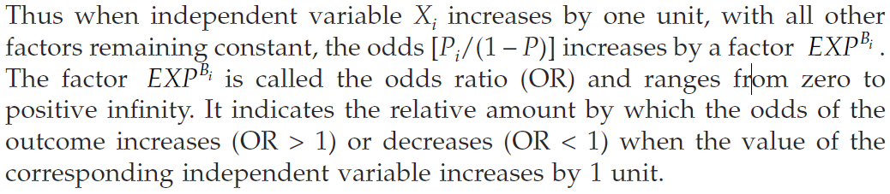
Logistic Regression

Slide 15
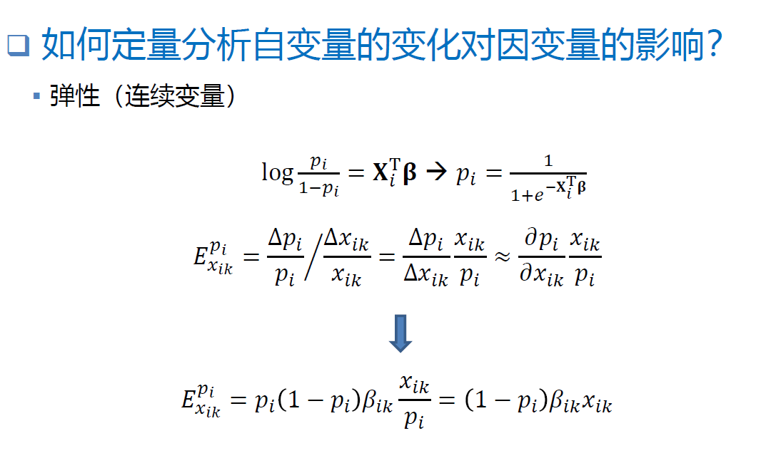
二项 Logistic 回归
❑ 如何定量分析自变量的变化对因变量的影响？
▪ 弹性（连续变量）

Slide 16
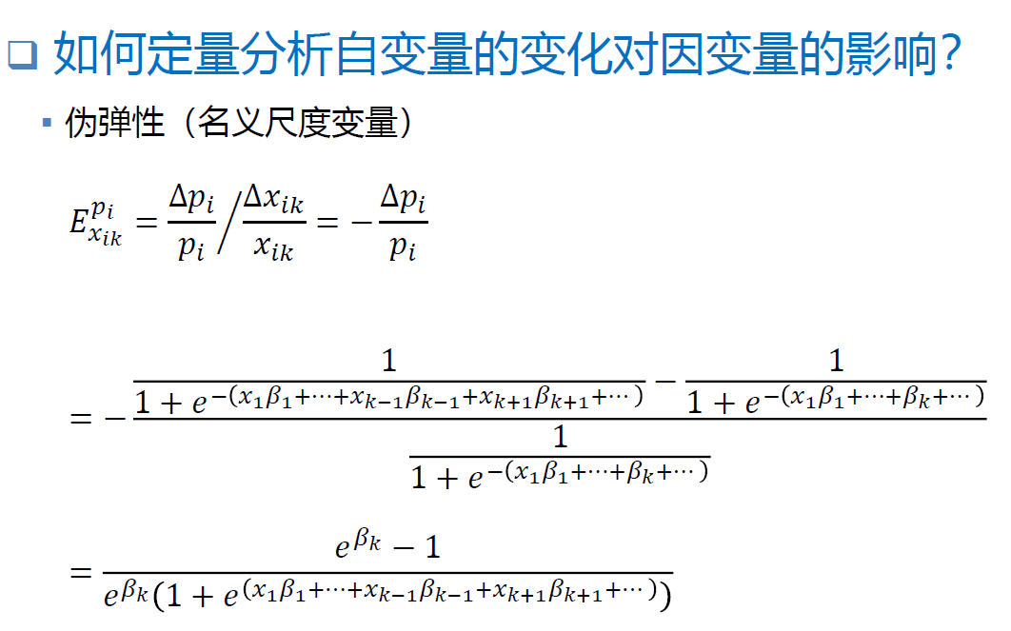
二项 Logistic 回归
❑ 如何定量分析自变量的变化对因变量的影响？
▪ 伪弹性（名义尺度变量）

Slide 17
Logistic Regression
The likelihood ratio test statistic is
where LL(β_{R}) is the log likelihood at convergence of the “restricted” model (sometimes considered to have all parameters in β equal to 0, or just to include the constant term, to test overall fit of the model), and LL(β_{U}) is the log likelihood at convergence of the unrestricted model.
The χ² statistic is χ² distributed with the degrees of freedom equal to the difference in the numbers of parameters in the restricted and unrestricted model (the difference in the number of parameters in the β_{R} and the β_{U} parameter vectors.

Slide 18
Logistic Regression
Another measure of overall model fit is the ρ² statistic. The ρ² statistic is
where LL(β) is the log likelihood at convergence with parameter vector β and LL(0) is the initial log likelihood (with all parameters set to zero).
The perfect model would have a likelihood function equal to one (all selected alternative outcomes would be predicted by the model with probability one, and the product of these across the observations would also be one) and the log likelihood would be zero, giving a ρ² of one.
Thus the ρ² statistic is between zero and one and the closer it is to one, the more variance the estimated model is explaining.

Slide 19
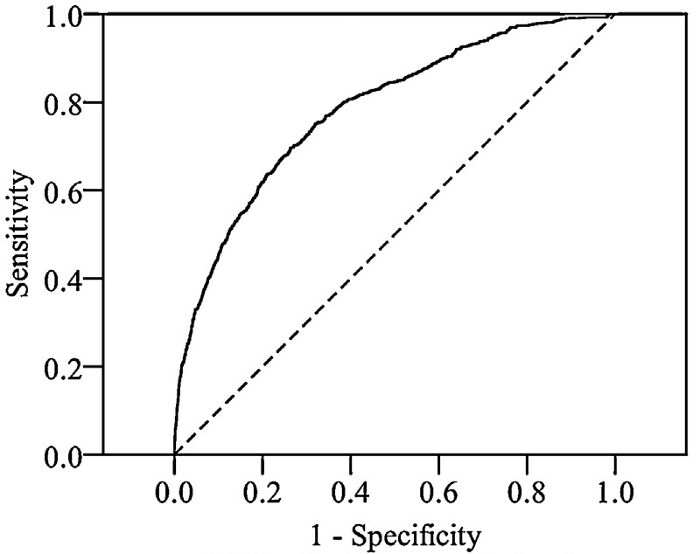
ROC Curve

Slide 20
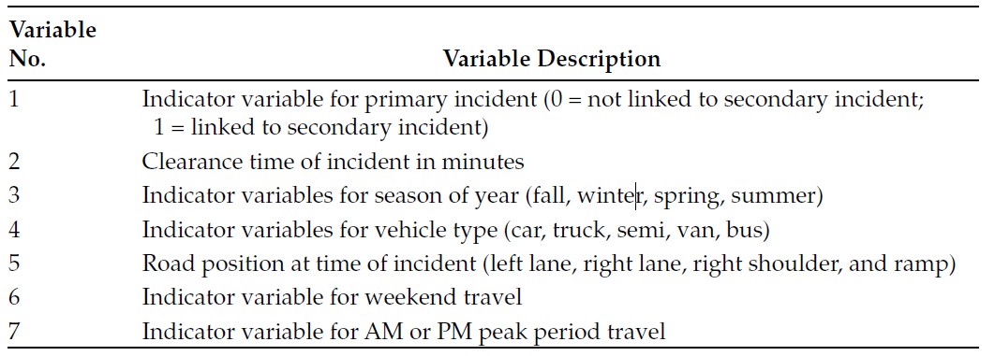
Logistic Regression

Slide 21
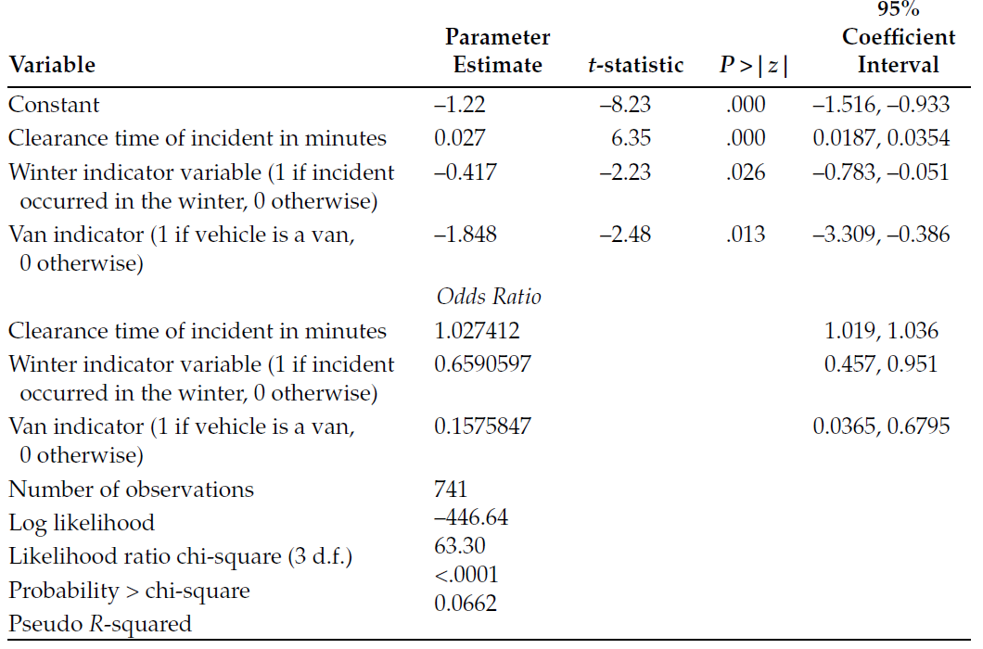
Logistic Regression

Slide 22
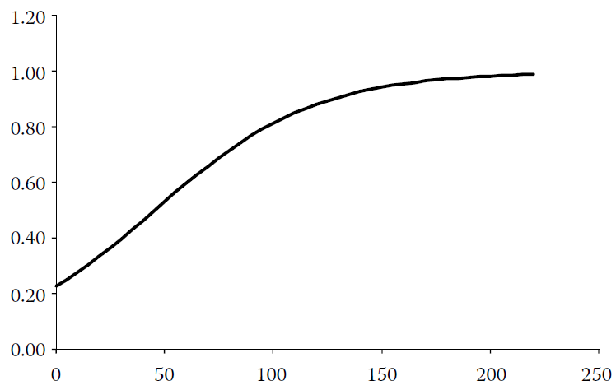
Logistic Regression

Slide 23
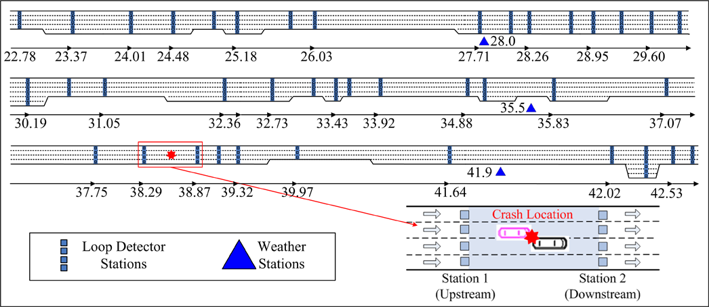
Logistic Regression

Slide 24
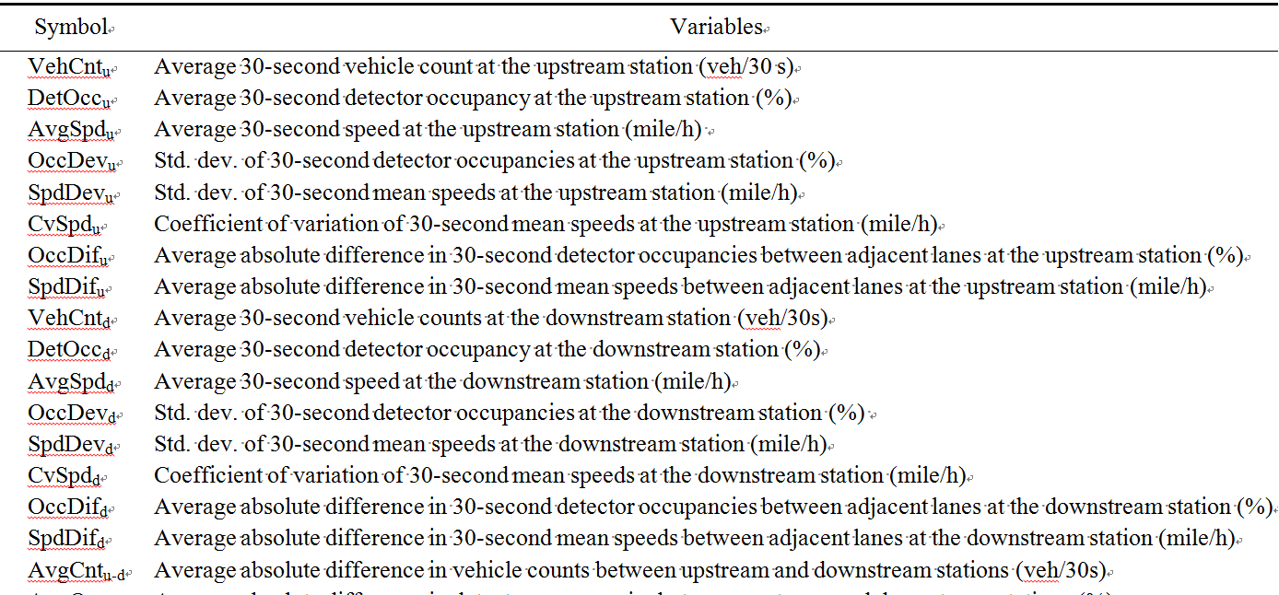
Logistic Regression

Slide 25
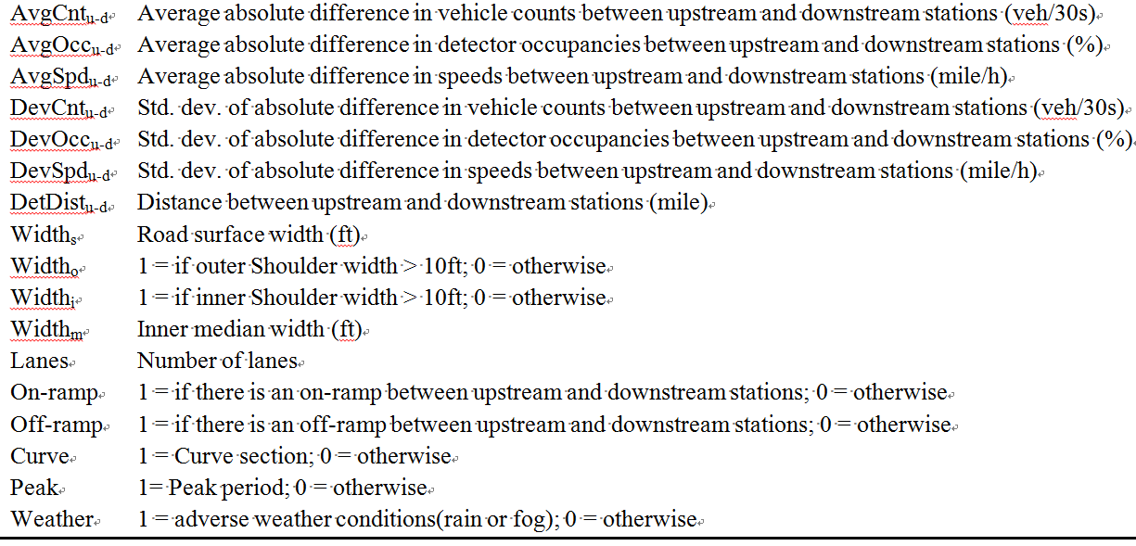
Logistic Regression

Slide 26
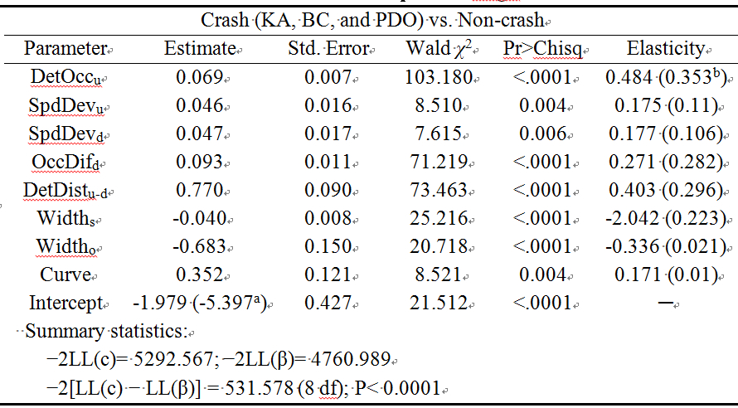
Logistic Regression

Slide 27
对数几率回归
❑ 学习目标
二项 Logistic 回归
多项 Logistic 回归

Slide 28
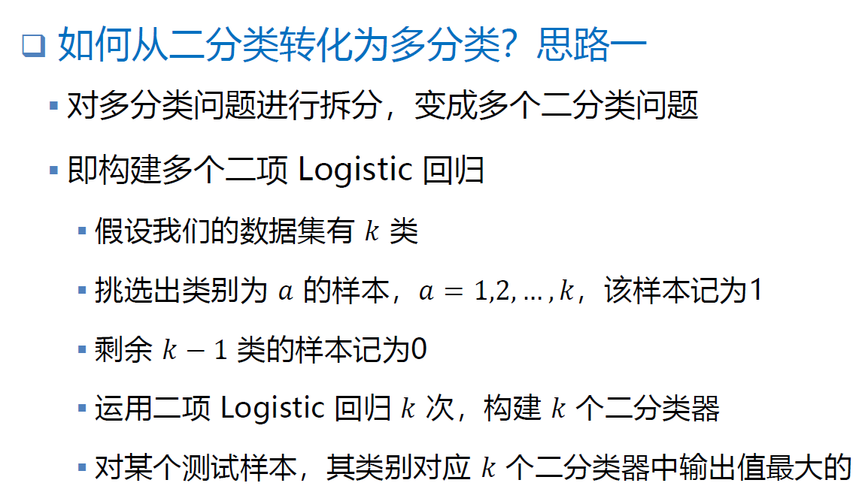
多项 Logistic 回归
❑ 如何从二分类转化为多分类？思路一
▪ 对多分类问题进行拆分，变成多个二分类问题
▪ 即构建多个二项 Logistic 回归

Slide 29

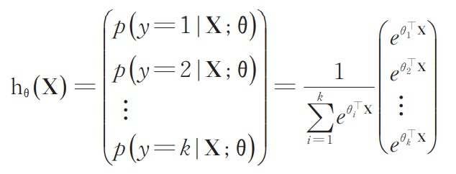
多项 Logistic 回归
❑ 如何从二分类转化为多分类？思路二
▪ 用 Softmax 函数替换对数几率函数
▪ Softmax 函数推广了对数几率函数

Slide 30
多项 Logistic 回归
❑ 多个二分类器 vs. Softmax 分类器
▪ 取决于样本数据中各类别之间是否互斥
▪ 若各类别之间明显互斥 → Softmax 分类器
▪ 若各类别之间有交叉 → 多个二分类器

